Slide 1

3. Develop a solution
Notes:
Teacher notes
This session helps students to refine their solution.
Students will consider their solution from different angles and gain feedback from their peers.
They will weigh up the pros and cons to their solution to help them advance it to one that is even better.
If students need help to find a problem to solve, please use session 1. If students have not yet found a solution to their problem, please use session 2.
This is the third of six sessions that work through the problem-solving process. They have been designed to form a basis for a one-hour session, but they can be used flexibly and adapted to suit the needs of your class. The seventh lesson provides further information on entering Google Science Fair.

Slide 2

1
2
4
5
6
7
Identify a problem
Generate ideas
Develop a solution
Design the test
Communicate the results
Draw conclusions
Enter the competition

Slide 3
Session 3: Outline
Headlines Activity 1: Starbursting Question time Activity 2: SWOT analysis Refining Storyboard (optional)
5 mins 10 mins 25 mins 10 mins 10 mins 20 mins
05 07 08 09 10 11

Slide 4


Materials you’ll need
A key question that clearly summarizes the problem you are going to solve A solution to your problem Writing supplies Activity 1: Starbursting Activity 2: SWOT analysis

Slide 5

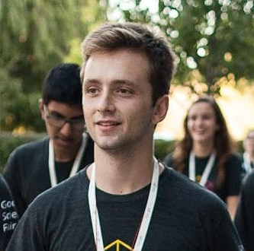
What do you think this project is about?
BUSINESS INSIDER
This Greek Teen Is Developing An Iron Man Hand
Play film
Notes:
Teacher notes
This activity is to encourage students to think about how they communicate their solution.
Explain that often the end user is not a scientist or engineer, so they need to think about how they can explain their idea clearly to a range of people.
If more time is available, students could try researching previous finalists to see how they were reported on. Or perhaps explore famous inventors. They can report back on what they found e.g. length of title, use of language.
Charalampos Ioannou was a finalist in the 2013 Google Science Fair. This headline was used by Business Insider to describe his project. http://www.businessinsider.com/this-greek-teen-is-developing-an-iron-man-hand-2013-6?IR=T
Ask students what they think Charalampos’ project was about?
Charalampos saw his grandmother struggling to grasp the TV remote. He was inspired to think about ways he could help people with hand disabilities. His solution was the exoskeleton glove.

Slide 6

Write a compelling headline about your solution
Notes:
Teacher notes
Students should be at a stage where they have come up with an idea/solution to their problem.
Ask students to summarize their solution into a headline.
If students have completed session 2, they can use the picture form of their solution as inspiration for their headline.
Encourage students to think about who the target audience of their solution is and how to phrase their headline to communicate with that audience.
If you have more time available, you could ask students to think-pair-share their headline ideas in twos to gauge how they sound.

Slide 7
Activity 1: Starbursting
Starbursting
Headline
How… ...will you make your solution a reality?
Who… ...is your audience / will it impact? ...causes the problem? ...can help? ...could you collaborate with?
What… ...supporting materials are you going to need? ...are your next steps?
Why... ...is this important to solve? ...is this solution better than others?
Where… ...will the solution work best? in the home? On a device? nationally? In the community?
Notes:
Teacher notes
This is a way to get students to brainstorm with a little structure.
If available, give students flipchart paper and ask them to complete a starburst, using the model above. Alternatively, use Activity 1: Starbursting.
Students can write their headline in the middle and use this technique to move their solution forwards.
Inform students they will be sharing their starburst with the class in the next activity.

Slide 8

Question time
Present your starburst. Once you’re done, get ready to answer quick questions from the class:
Have you considered…
Why have you chosen…
Have you thought about…
Maybe you could look at…
As an alternative you could…
In terms of impact…
Notes:
Teacher notes
Time for some discussion and debate.
Inform students they will present their starburst to the class (two mins max) and then their peers are allowed to ask questions.
Encourage students to question supportively and constructively so that ideas are pushed forward.
Share these sentence stems with students to help them formulate suitable questions.

Slide 9
Activity 2: SWOT analysis
SWOT analysis
Strengths
Weaknesses
Opportunities
Threats
Notes:
Teacher notes
Explain that now students have feedback, they can analyze it to inform next steps.
Ask:
What are the strengths of your solution?
What are the weaknesses of your solution?
What opportunities arise from this solution?
What threats are there to it?
Ask students to complete Activity 2: SWOT analysis.

Slide 10

Question time
Starbursting
SWOT analysis
Refine
Notes:
Teacher notes
Students will now have considered their solution with different focus points via starbursting, feedback from their peers and a SWOT analysis to recognize any areas for further development.
Encourage students to use the intel from the three activities to refine their idea.
These questions could help them:
What works well?
Could this be mirrored elsewhere?
What can you do about the identified weaknesses and threats?
How will you embrace any opportunities that have been highlighted?
What suggestions can be incorporated into your solution?
Explain that refining your solution is key to innovation - they can go through this process more than once if they feel like there is more to explore.

Slide 11
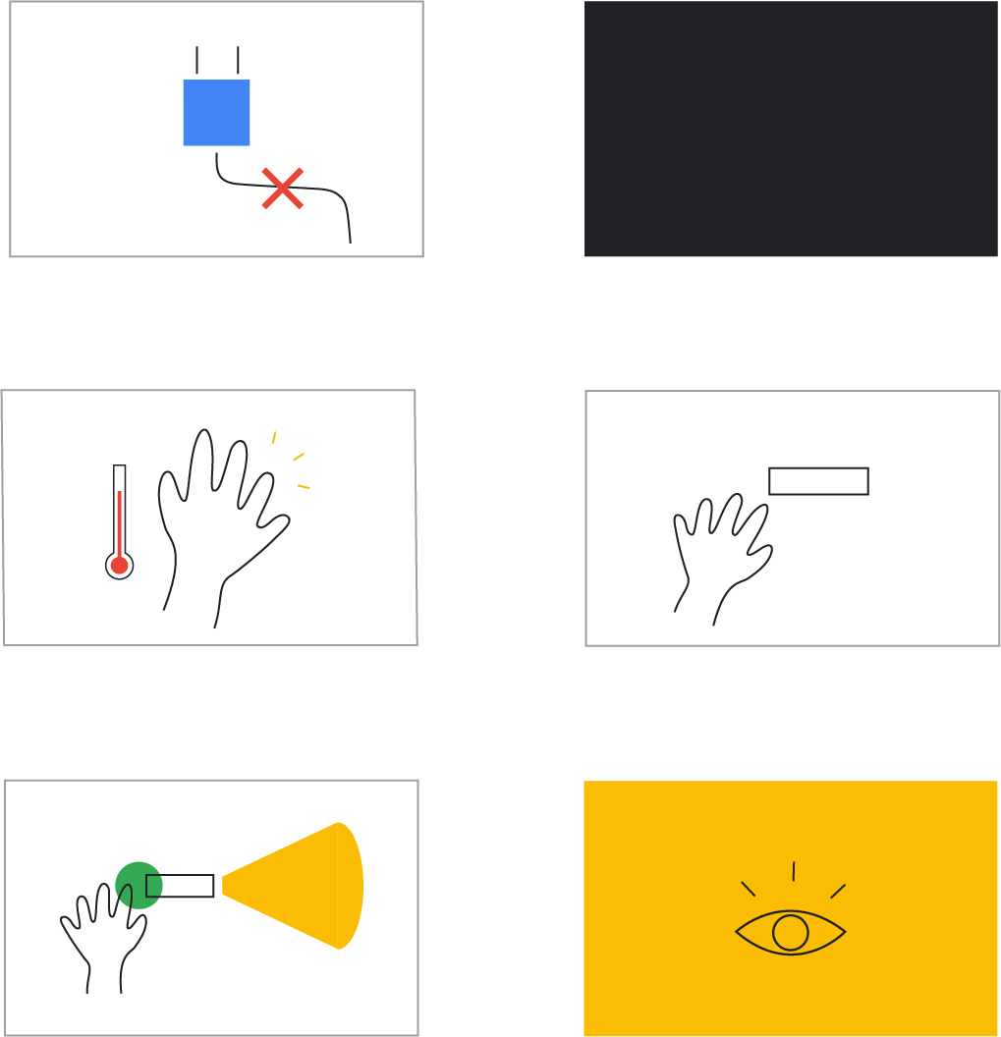
Storyboard
1
2
Many people don’t have access to or cannot afford electricity
This prevents certain activities, such as studying at night
Show how your solution improves the lives of people around you.
3
4
The human hand naturally produces heat energy
Peltier tiles convert heat energy into electricity
5
6
The LED flashlight is powered on when held in hand
The result is a light source that isn’t dependant on money
Notes:
Optional
Teacher notes
Students should now have a clear picture of their solution, which has evolved from what it originally was.
At this stage, a storyboard is a nice technique to keep the solution in context, reminding students it is not just the solution and the subsequent design of it that are important, but who it impacts and how it fits into the bigger story.
The main character is the user, so students must create a storyboard that shows how the user would interact with the product/idea/solution in an environment or situation that that is typical for the design.
Students break down and draw out the sequence of events that the user would take to overcome the problem through the use of their solution.
They should show how the user interacts in the environment or the experience of using the the product or system that they have designed.
Students can use this to break down their final design and take it forward into testing.

Slide 12
Now you have your solution, it’s time to design your test!
Session 4: Design the test

